Slide 1
Collection framework – Generics
Object Oriented Programming with Java
Chapter 6
FPTU Da Nang – IT Department

Slide 2
Objectives
Generics essential.
  Generic class and interface
  Generic methods
Introduction to Collections framework
Collections framework
  List : ArrayList, LinkedList, Stack, Queue
  Set : HashSet, TreeSet
  Map: HashMap, TreeMap

Slide 3
Generics
Generics enable types (classes and interfaces) to be parameters when defining classes, interfaces and methods.
Generics has many benefits over non-generic code:
  Stronger type checks at compile time
  Elimination of casts
  Enabling programmers to implement generic algorithms
A generic class is defined with the following format:
  class name<T1, T2, ..., Tn> { /* ... */ }
  public class Box<T> { // T stands for "Type" can be any non-primitive type
  private T t;
  public void set(T t) { this.t = t; }
  public T get() { return t; }
  }

Slide 4
Generics
Type Parameter Naming Conventions
  E - Element (used extensively by the Java Collections Framework)
  K - Key
  N - Number
  T - Type
  V - Value
  S,U,V etc. - 2nd, 3rd, 4th types
Invoking and Instantiating a Generic Type
    generic type invocation replaces T with concrete value: type argument
    Box<Integer> integerBox = new Box<Integer>();
    pair of angle brackets, <>, is informally called the diamond
    Box<Integer> integerBox = new Box<>();
  Generic class can have multiple type parameters

Slide 5
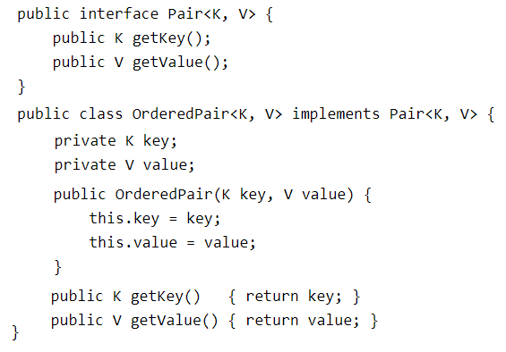
Generics
  Generic class can have multiple type parameters

Slide 6
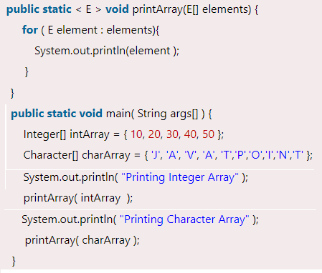
Generic methods
Generic methods are methods that introduce their own type parameters
  The syntax for a generic method includes a list of type parameters, inside angle brackets, which appears before the method's return type.
bounded type parameters
  to restrict the types that can be
  used as type arguments
  type parameter's name,
  followed by the extends keyword,
  followed by its upper bound;
  or followed by the super keyword,
  followed by its lower bound
  the question mark (?), called the wildcard,
  represents an unknown type
  public static void drawShapes(List<? extends Shape> lists)
  public static void addNumbers(List<? super Integer> list) {

Slide 7
Restrictions on Generics
Cannot Instantiate Generic Types with Primitive Types
Cannot Create Instances of Type Parameters
Cannot Declare Static Fields Whose Types are Type Parameters
Cannot Use Casts or instanceof With Parameterized Types
Cannot Create Arrays of Parameterized Types
Cannot Create, Catch, or Throw Objects of Parameterized Types
Cannot Overload a Method Where the Formal Parameter Types of Each Overload Erase to the Same Raw Type

Slide 8
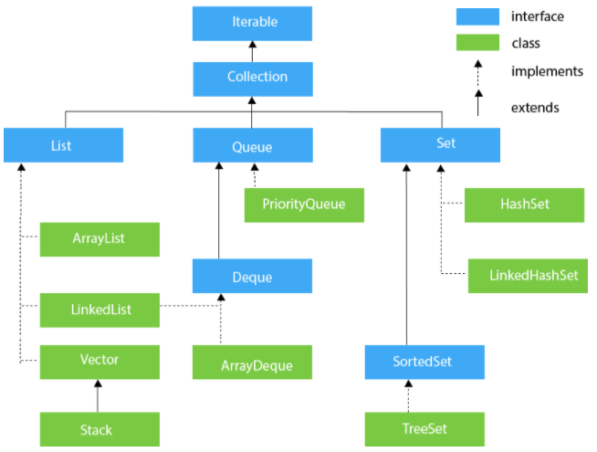
Collection framework

Slide 9
List – dynamic array
List provides the facility to maintain the ordered collection.
  contains the index-based methods
  can have the duplicate elements
  can store the null elements in the list. classes of List interface are ArrayList, LinkedList, Stack and Vector
  implementation classes of List interface are ArrayList, LinkedList, Stack and Vector

Slide 10
ArrayList
Dynamic array for storing the elements.
  It is like an array, but there is no size limit.
  can contain duplicate elements.
  maintains insertion order.
  non synchronized.
  allows random access because array works at the index basis.
  manipulation is little bit slower than the LinkedList because a lot of shifting needs to occur if element is removed from list.
  better for storing and accessing data

Slide 11
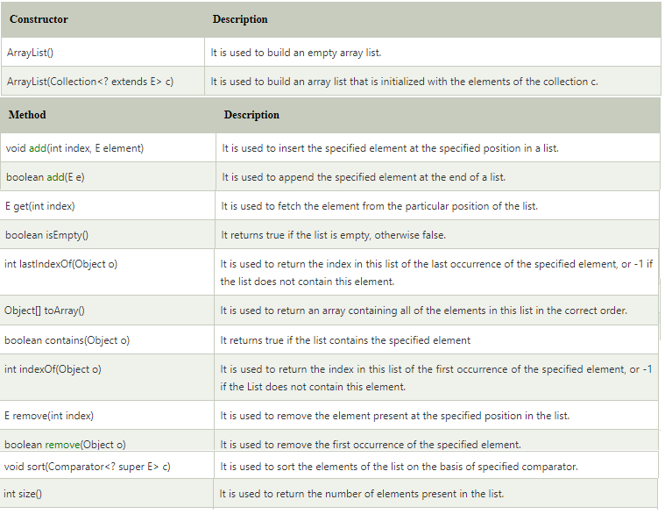
ArrayList

Slide 12
LinkedList
LinkedList uses a doubly linked list to store the elements.
  manipulation is fast because no shifting needs
  can contain duplicate elements.
  maintains insertion order.
  non synchronized.
  can be used as a list, stack or queue
  better for manipulating data.

Slide 13
HashSet
HashSet is used to create a collection that uses a hash table for storage.
  stores the elements by using a mechanism called hashing.
  contains unique elements only.
  allows null value.
  non synchronized.
  doesn't maintain the insertion order.
  inserted on the basis of element hashcode.
  best approach for search operations.

Slide 14
TreeSet
TreeSet implements the Set interface that uses a tree for storage.
  contains unique elements only.
  access and retrieval times are quiet fast.
  doesn't allow null element.
  non synchronized.
  maintains ascending order

Slide 15
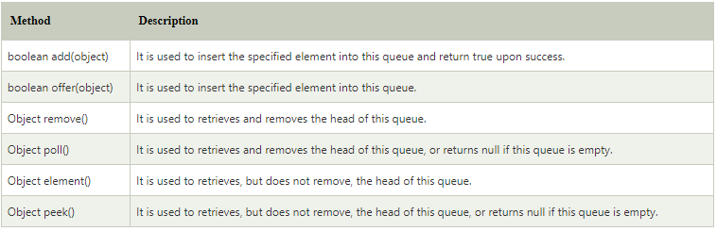
Queue – Deque - Stack
Queue orders the element in FIFO(First In First Out).
Deque is a linear collection that supports element insertion and removal at both ends. Deque is an acronym for "double ended queue".
Stack store the collection of objects in LIFO Last-In-First-Out

Slide 16
Map
A map contains values on key-value pair.
  Each key-value pair is known as an entry.
  A Map contains unique keys, but can have duplicate values
A Map is useful for search, update or delete elements on the basis of a key.
HashMap and LinkedHashMap allow null keys and values, TreeMap doesn't allow any null key or value.
Map can't be traversed, convert it into Set using keySet() or entrySet() method.

Slide 17
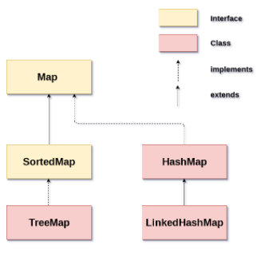
Map
HashMap is the implementation of Map, doesn't maintain any order.
LinkedHashMap inherits HashMap and maintains insertion order.
TreeMap is the implementation of Map and SortedMap. It maintains ascending order.

Slide 18
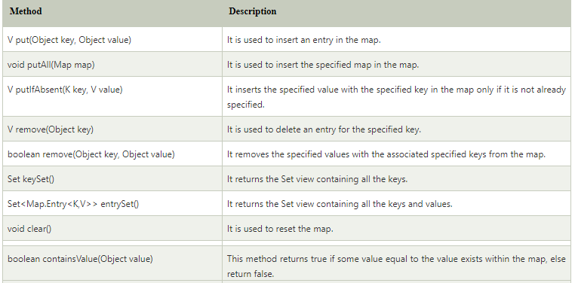
Map

Slide 19
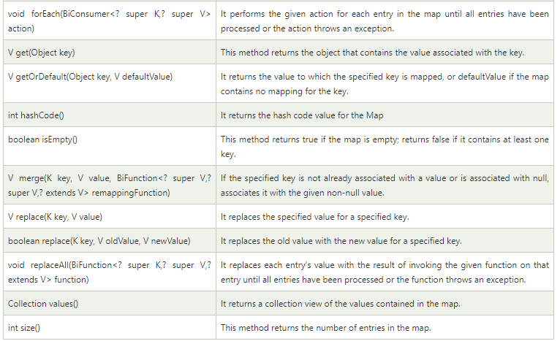
Map

Slide 20
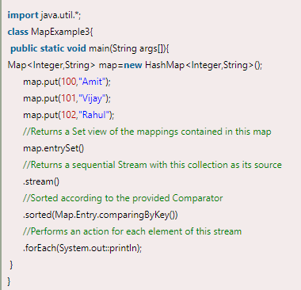
Map

Slide 21
Homework
Develop Library Management application:
  Book searching
  User registration
  Book borrow - return
  Add new book
  Renew booking
  View logs
  List over-due book

Slide 22
Constructive questions
Compare ArrayList and LinkedList
For effective searching Book by BookID, how should the the book catalog be organized?
Analyze the difference of search algorithm on ArrayList and on TreeSet
Find real life data examples that has similar structure as Stack, Queue
Analyze the difference of search algorithm on HashMap and on TreeMap

Slide 23
Constructive questions
Find real life examples that illustrate the benefits of using generics
Why can't cast or use instanceof with Parameterized Types?
Write a function that prints the information of an arbitrary list of objects as arguments to the function.
Write a search function that takes any object as an argument and any search condition.

